Slide 1

Grant Rataski, Charles James, Alex Sheriff, Tameah Young

Slide 2
Purpose
E-Commerce Website for SneakerHeads
Prioritize User Experience
Stripe with Google pay option as Payment Method
Notes:
Charles

Slide 3
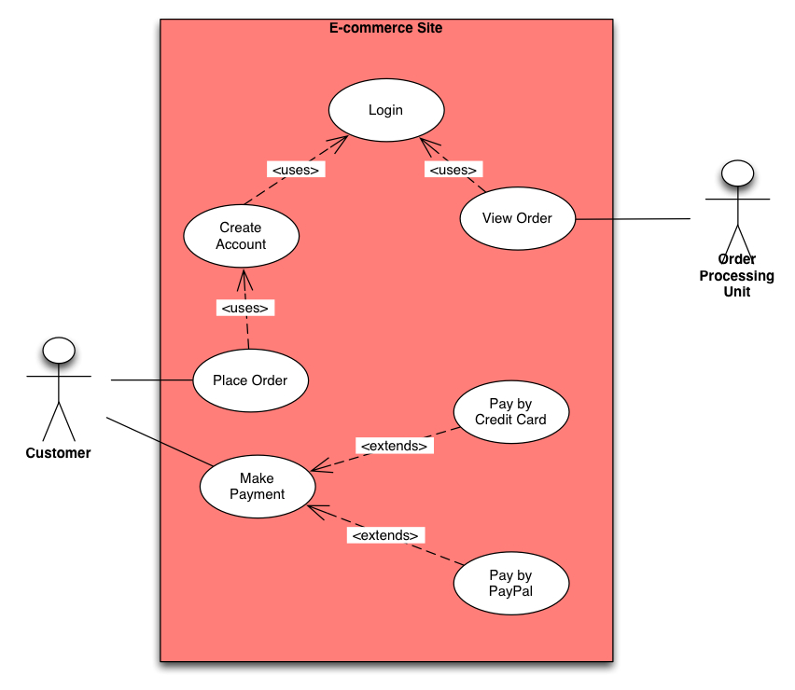
Use Case Diagram
Notes:
Alex

Slide 4








Architecture
AWS Lightsail Private Server
AWS Lightsail instance
Internet
Users
Cloudflare
Apache with php running wordpress
AWS Lightsail Firewall
AWS Route 53
shoetersfashion.com
Notes:
Tameah

Slide 5
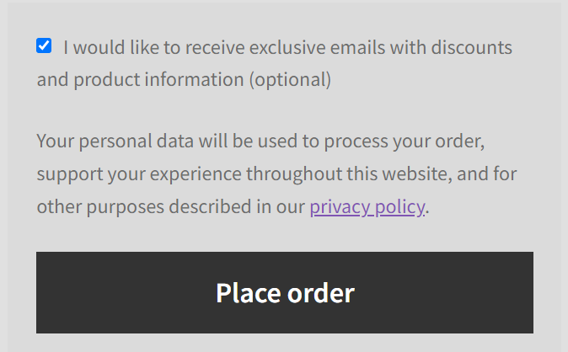
Privacy Policy Highlights
We make sure that before checking out, the shopper can view our privacy policy. The privacy policy page is also displayed in two separate links on our site.
We collect personal and financial information (Card numbers)
We try to the best of our ability to secure and store your information through reasonable means.
We collect information from cookies like location data, log and usage data, and device data.
Notes:
Alex

Slide 6
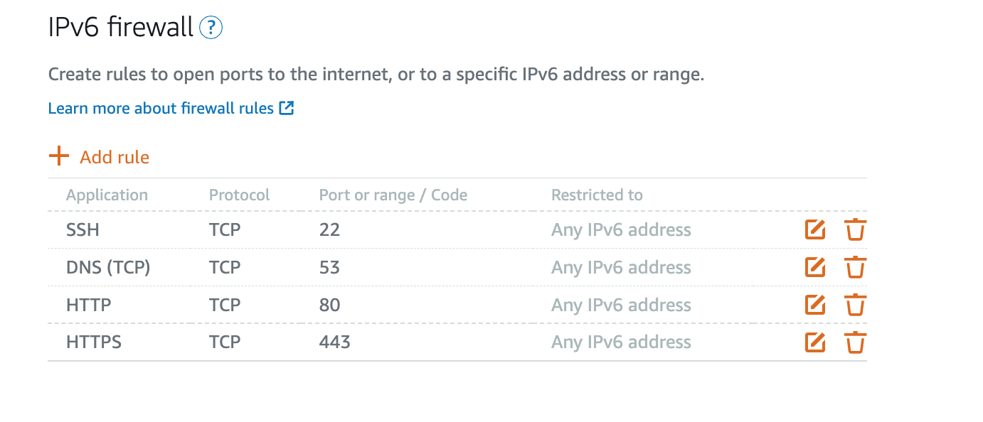
Firewall Rules Before Scan
Notes:
Grant- left any ip address initially when adding firewall rules. Added only 4 rules initially. Talk about PING firewall and why not used- spoofing The most important rules i considered were SSH to secure connection between devices over network, DNS to prevent users to connecting to malicious locations. Then just the standard http and https all open to allow traffic.

Slide 7
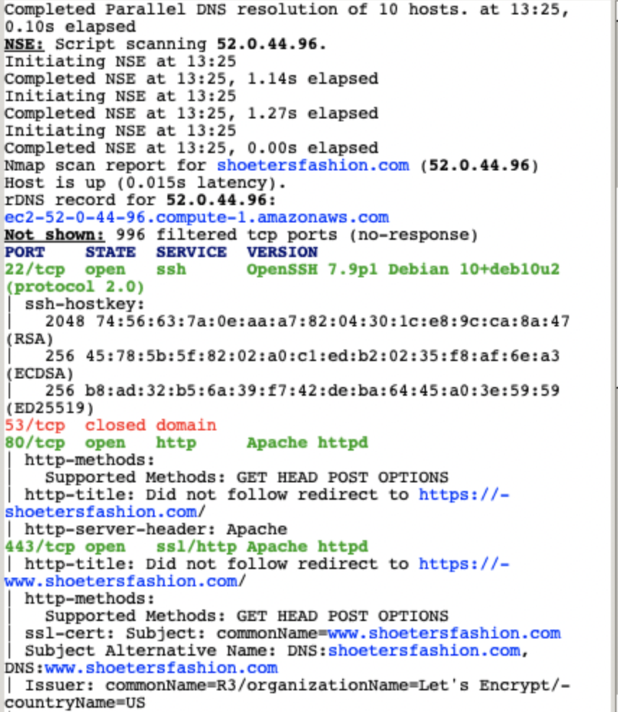
Vulnerability scan
Notes:
Tameah

Slide 8
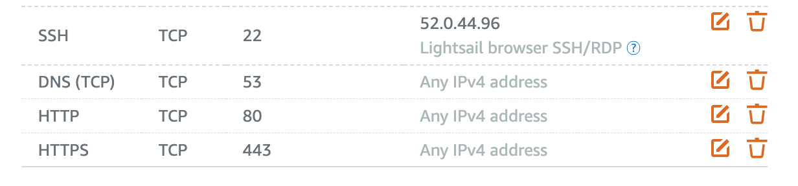
Firewall Rules After Scan
Notes:
Grant- restricted to our private ip address to prevent our key from showing up in vulnerability scans

Slide 9
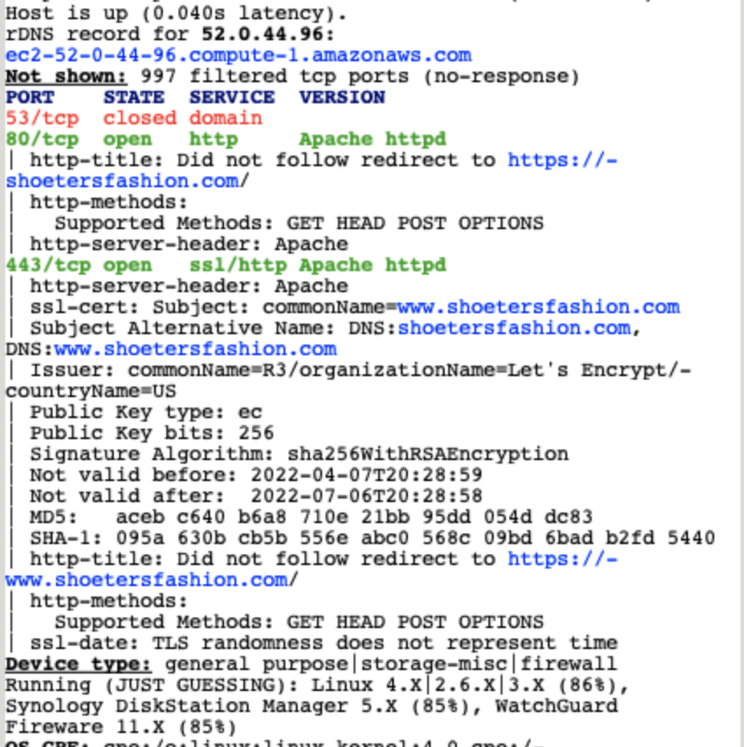
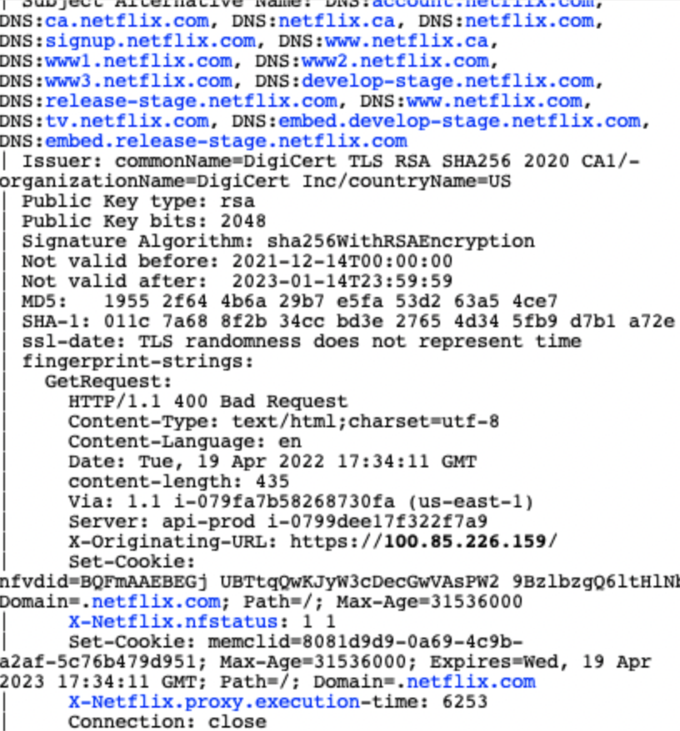
Vulnerability Scan After Change
Netflix scan
Notes:
Tameah

Slide 10
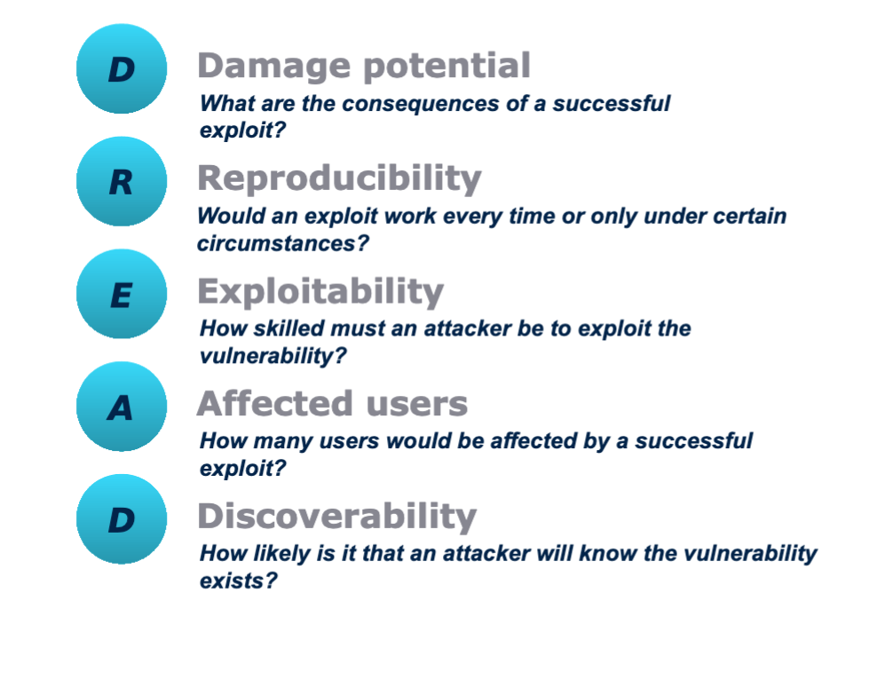
Mitigation Model- DREAD
Notes:
Grant

Slide 11
DREAD Model Example 1:
Threat | D | R | E | A | D | Total | Risk
Denial of Service to Users | 3 | 2 | 2 | 3 | 3 | 13 | HIGH
Notes:
Grant- highest risk to us, user experience affected, implementation of cloudwatch events and SSL

Slide 12
DREAD Model Example 2:
Threat | D | R | E | A | D | Total | Risk
Cross site Scripting | 3 | 2 | 2 | 2 | 2 | 11 | Medium
Require an account with anytype of posting capabilities (contributor role)
Possible to hijack user’s account
Notes:
CHarles

Slide 13
Input Validation
Used to ensure the information that is being input by the user is within compliance of the application/website.
Address validation via woocommerce (loqate)
Email and name validation when creating a new account via wpforms
Notes:
Charles

Slide 14
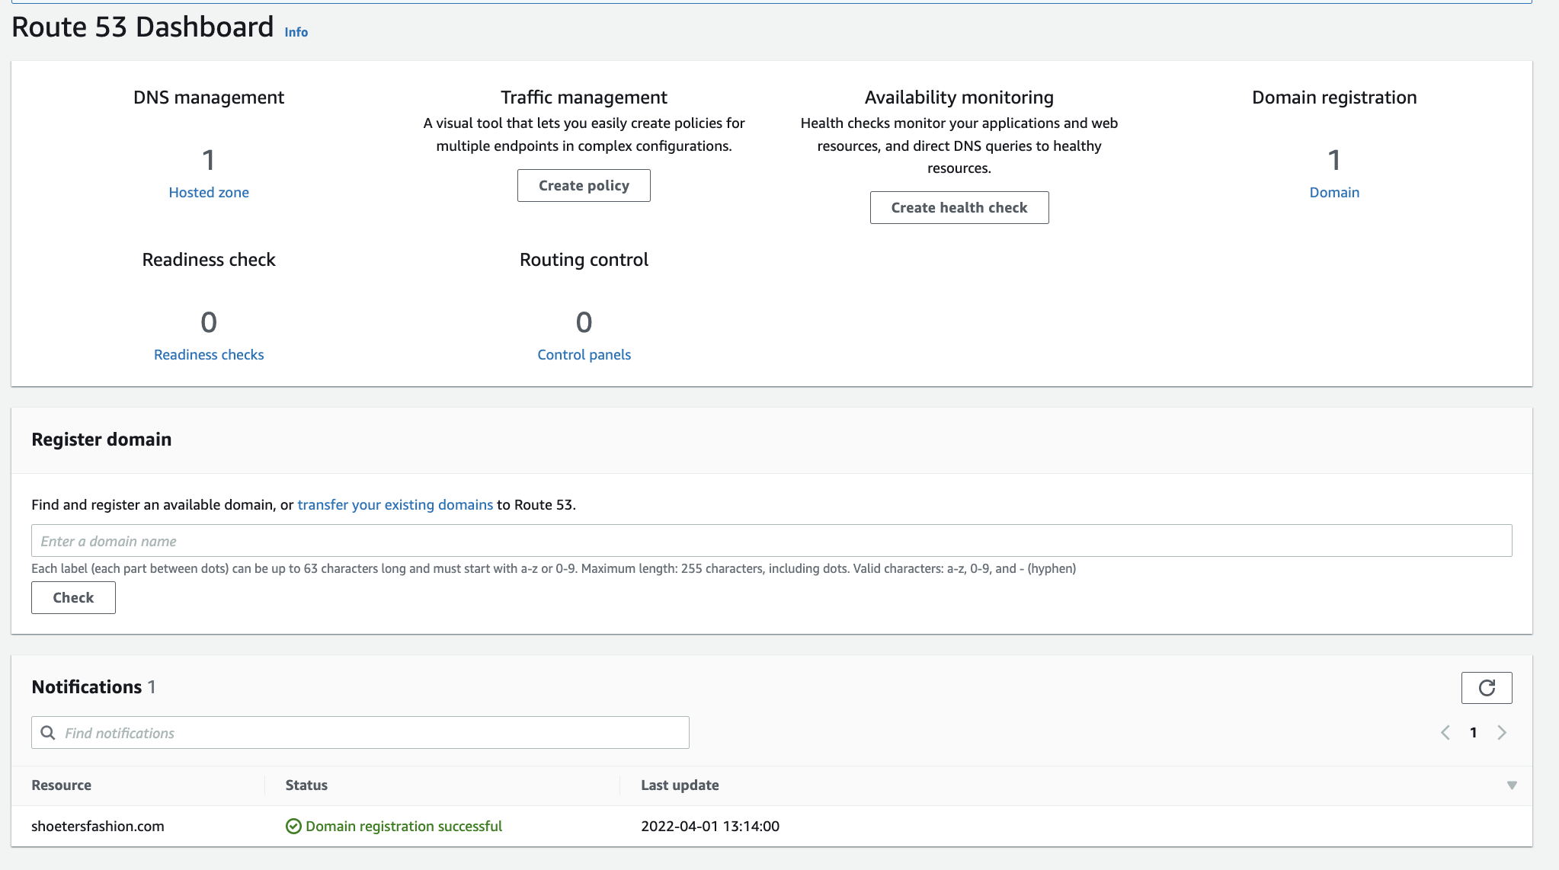
Architecture Approach
AWS route 53
Domain server name
Shoetersfashion.com
Notes:
Tameah

Slide 15
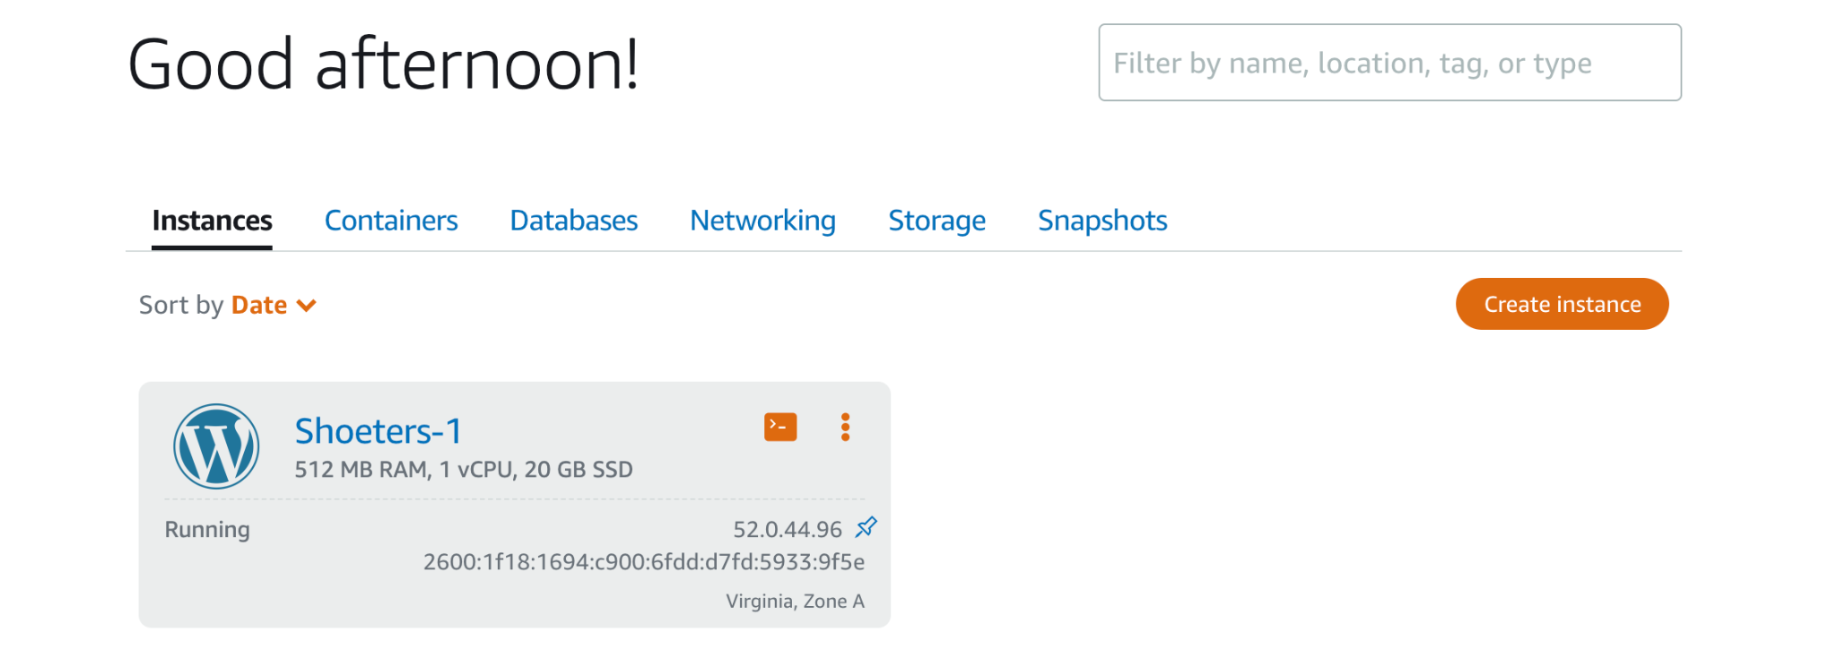
Architecture Approach
AWS Lightsail
Deployed using Wordpress
Notes:
Tameah

Slide 16
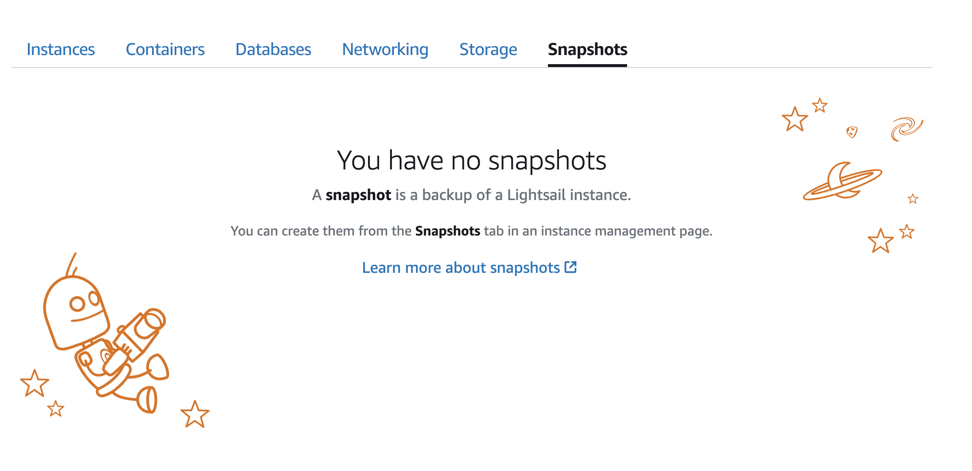
Automatic Snapshot Option - Lightsail
Can be used for data recovery or data backup
Costed extra money for snapshot storage

Slide 17
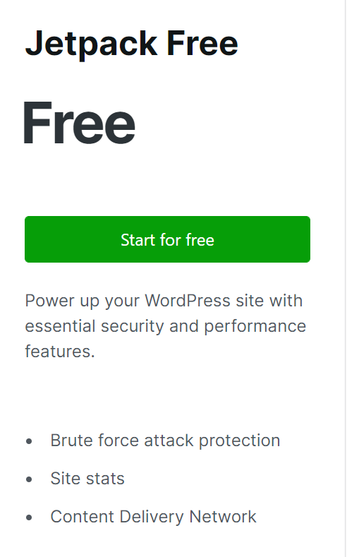
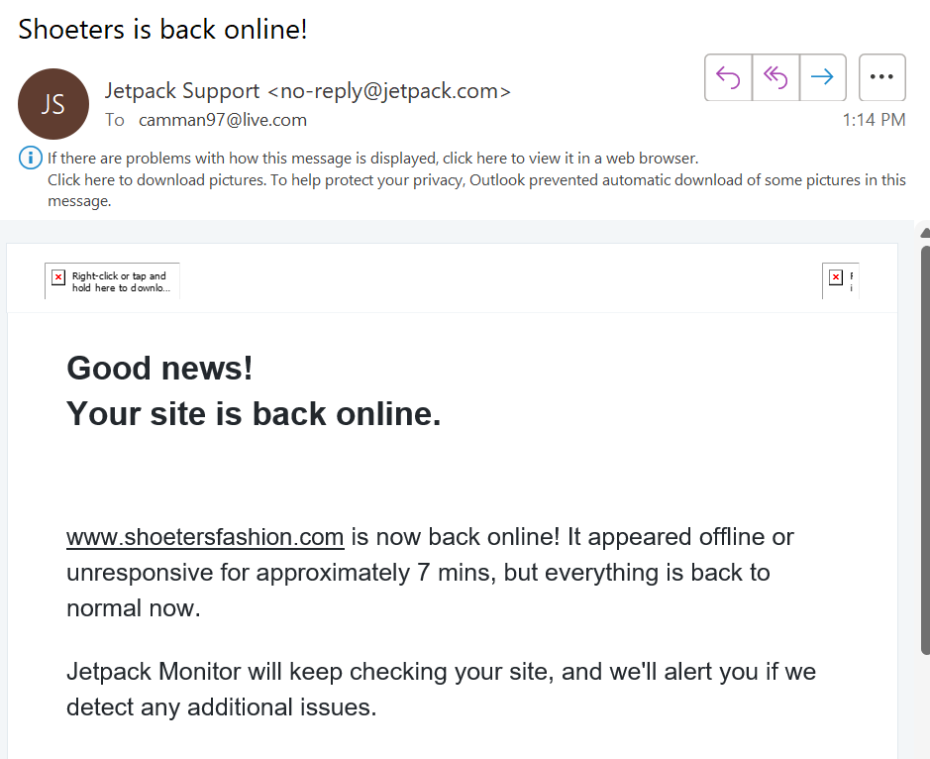
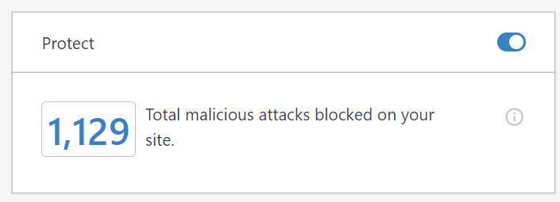
WordPress: Jetpack Security Plugin
Notes:
Alex

Slide 18
Counter Back-End Attacks Strategy
Firewall and WAF
Strong Authentication for users and admin
Cloudflare threat protection
Encryption in transit or at rest
Whole Database Encryption
Notes:
Alex

Slide 19
Alarm Events
Alarms set for Incoming network traffic, CPU Utilization, Instance Status
Notified by email
Notes:
Grant- all affect user experience.. Incoming network traffic and cpu increase will cause delay for user requests. Instance status check allows to see if instance is running successfully

Slide 20
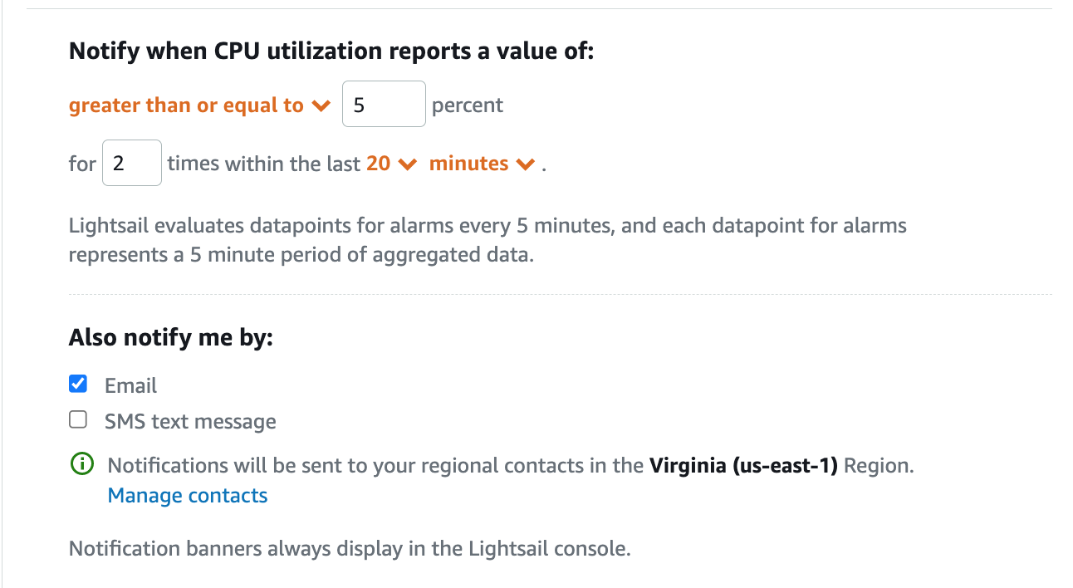
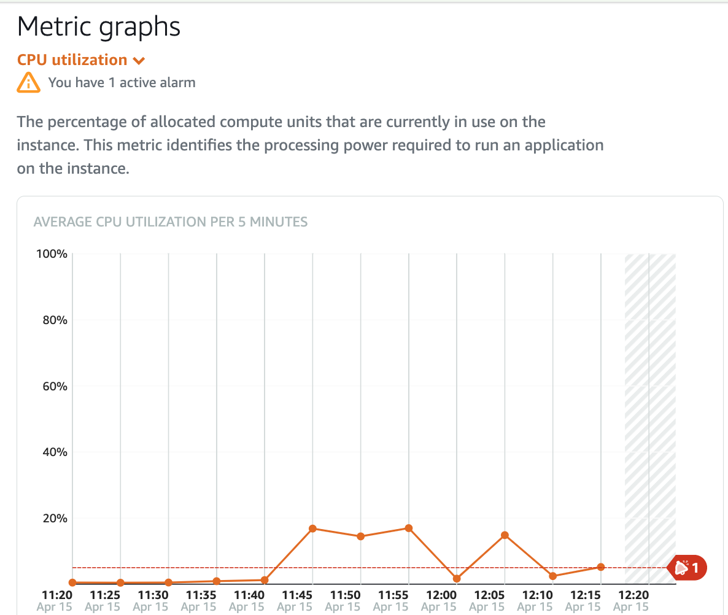
CPU Utilization Alarm
Notes:
Grant

Slide 21
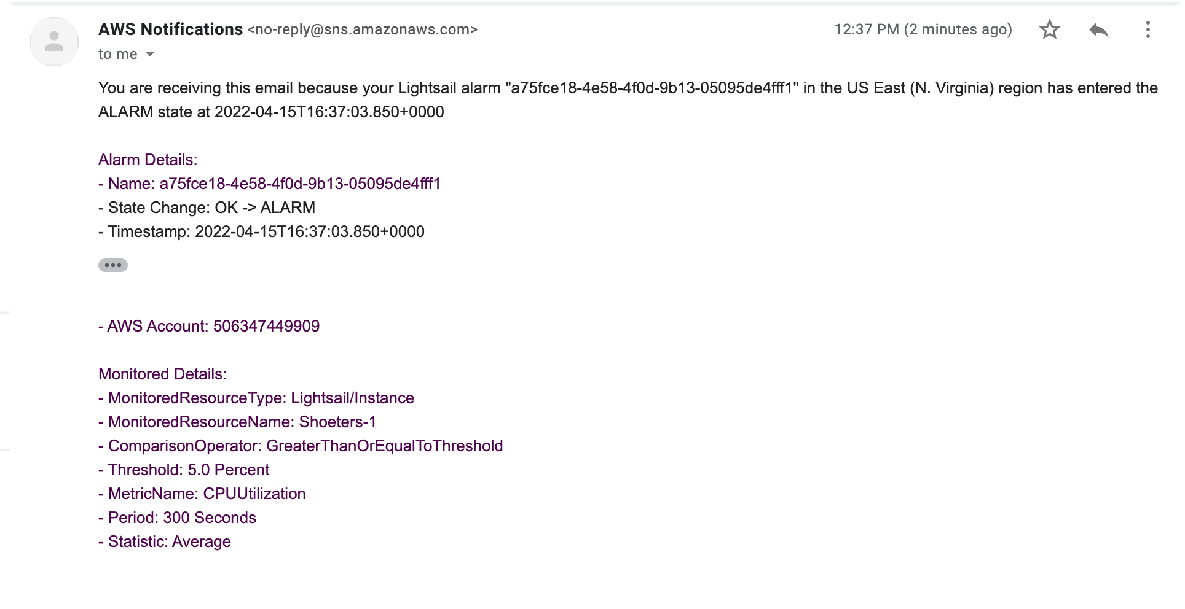
Alarm Notification- CPU Utilization
Notes:
Grant

Slide 22
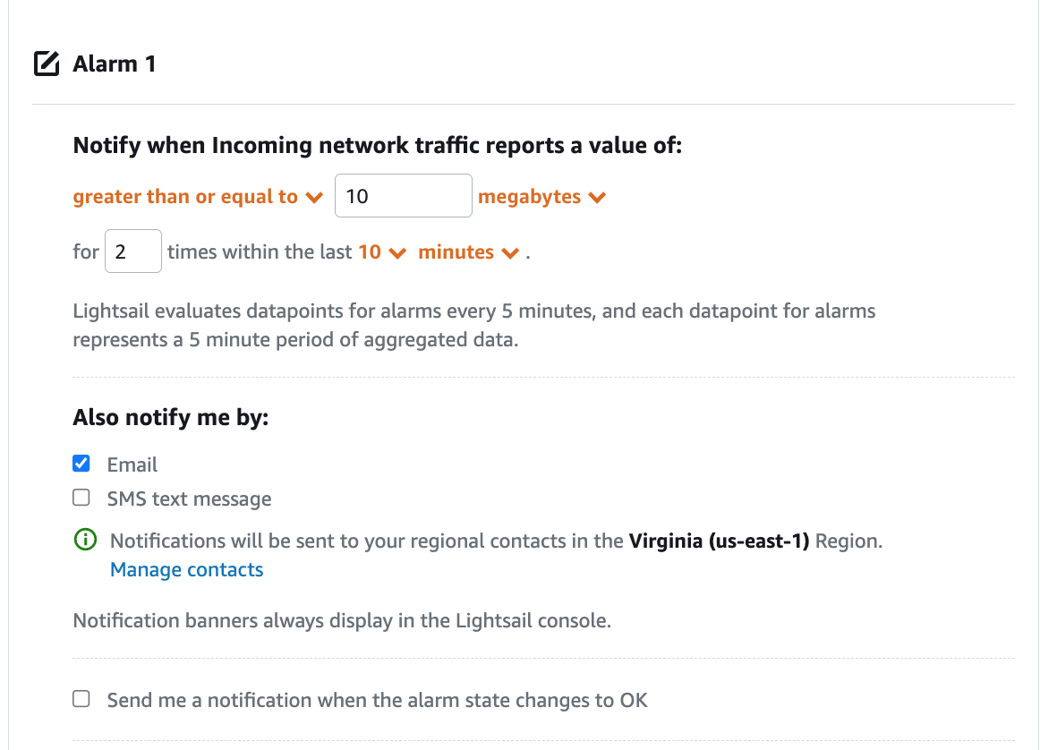
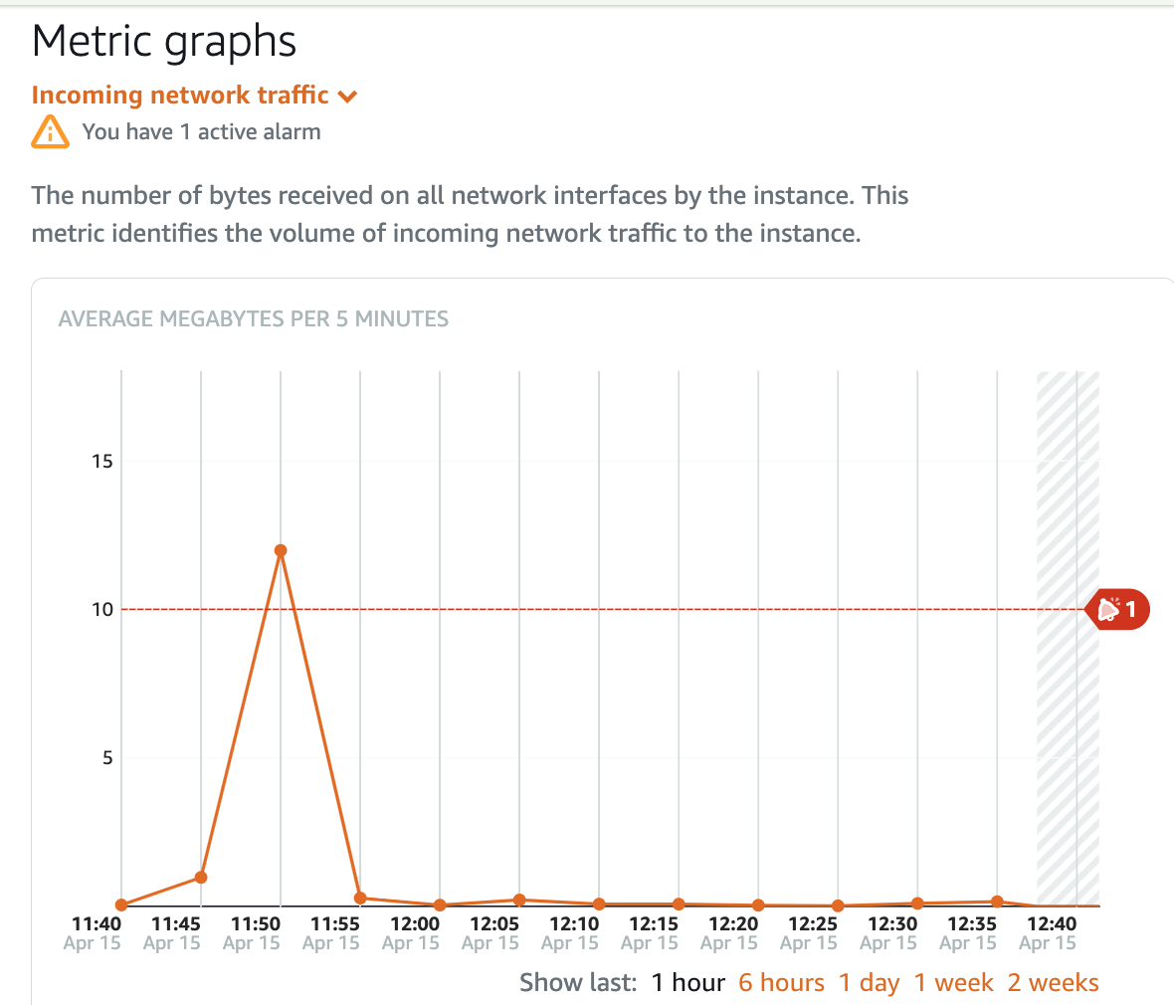
Incoming Network Traffic Alarm
Notes:
Grant

Slide 23
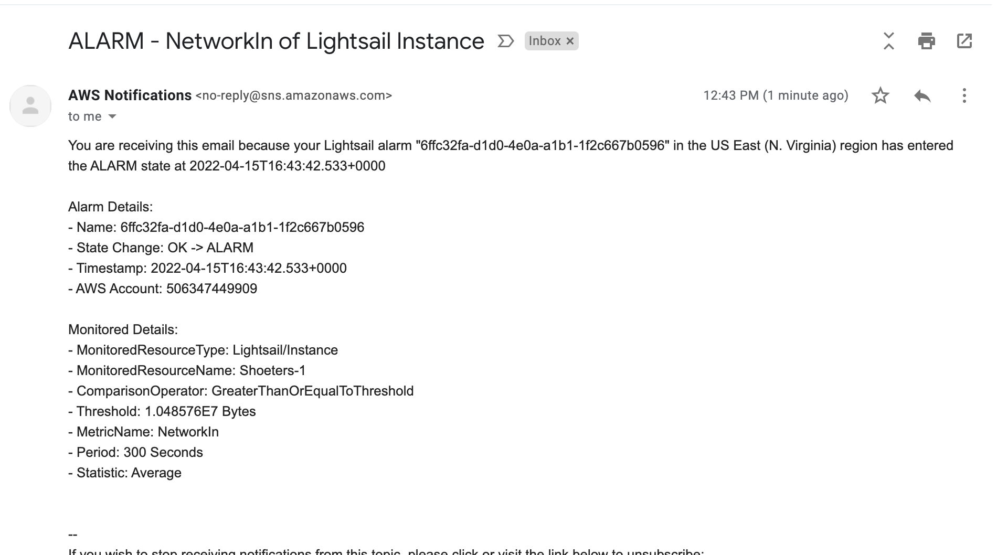
Alarm Notification- Incoming Network Traffic
Notes:
Grant

Slide 24
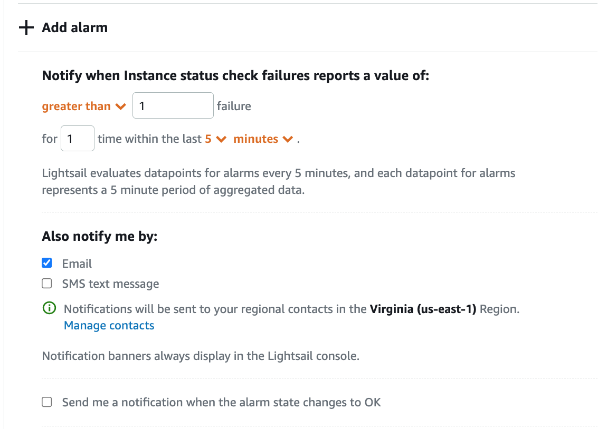
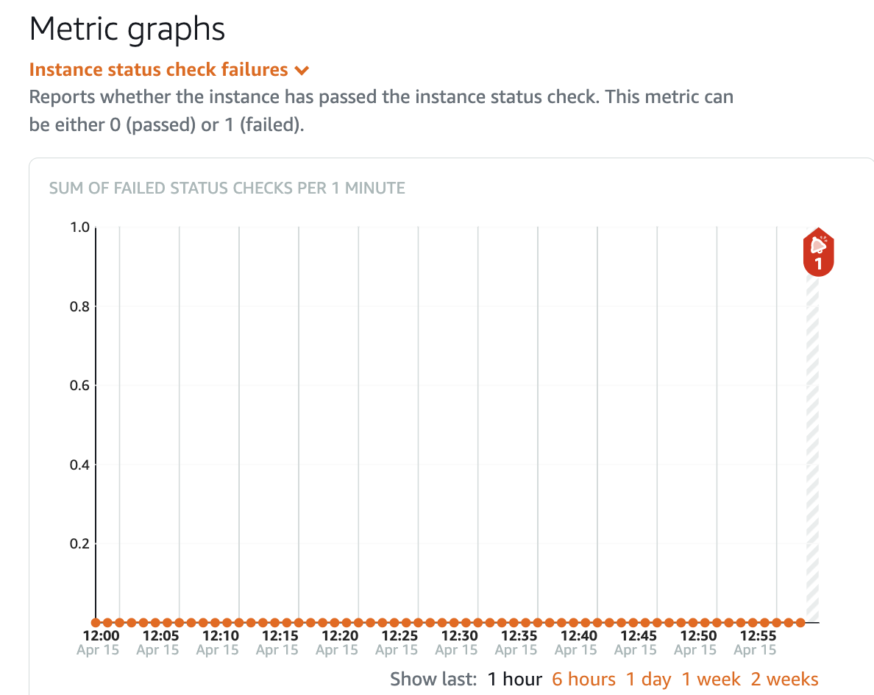
Instance Status Check Alarm
Notes:
Grant

Slide 25
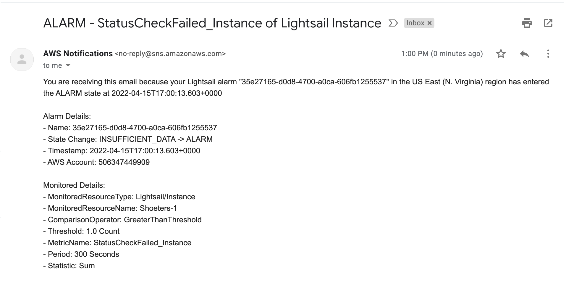
Alarm Notification- Instance Status
Notes:
Grant

Slide 26
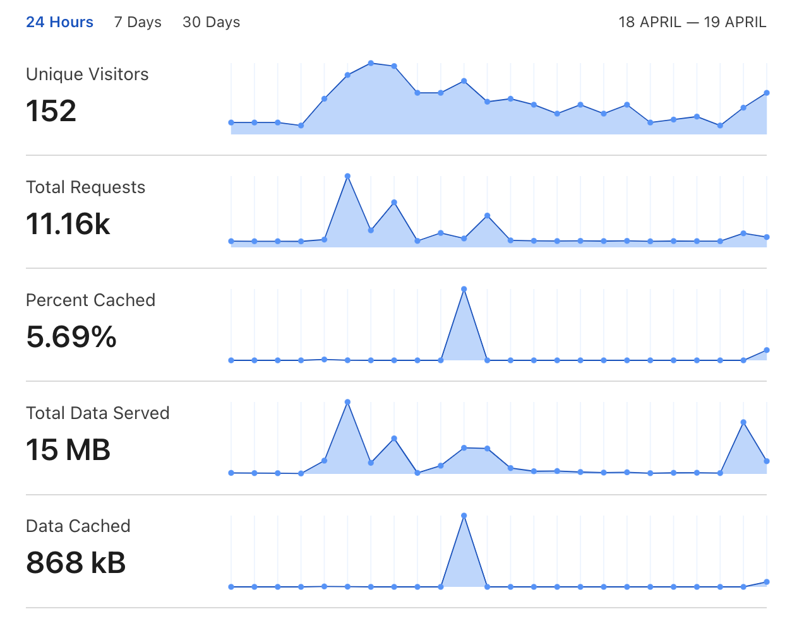
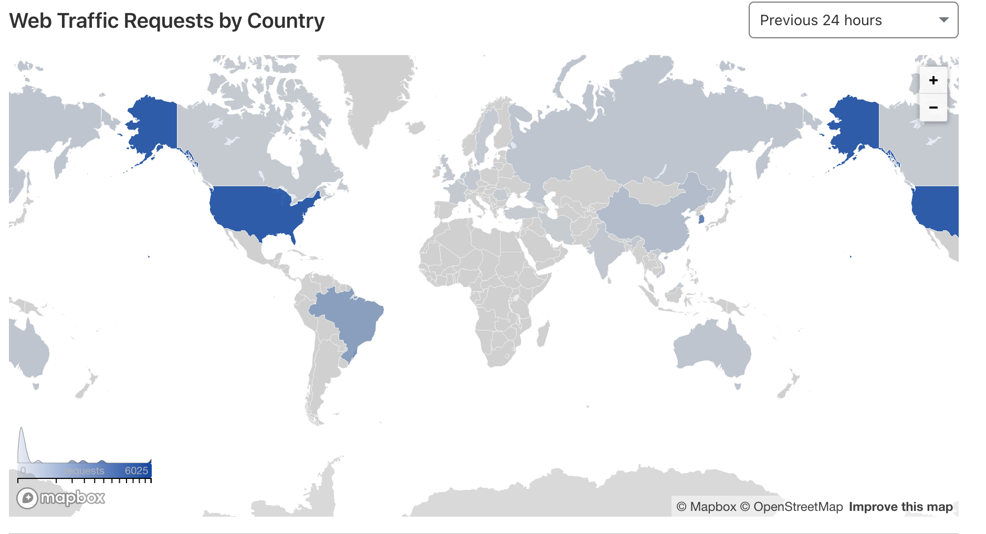
Metrics - Cloudflare

Slide 27
Scaling Approach
Reactive Approach
LightSail has option to launch load balance instances
18$/month to use load balancers
Autoscale our load balancers based off our alarms
Use of Availability Zones
AWS Macie
Notes:
Grant- if one instance fails on load balancer the other would pick up, also would autoscale. Alarms would be set to autoscale. AWS Macie would have been implemented if wasn’t so expensive- machine learning to scale up or down sensitive data– learns the custom data we set up and sends cloudwatch alerts to autoscale. Since only using one instance and no load balancers. Couldn;t configure the alarms to auto scale.

Slide 28
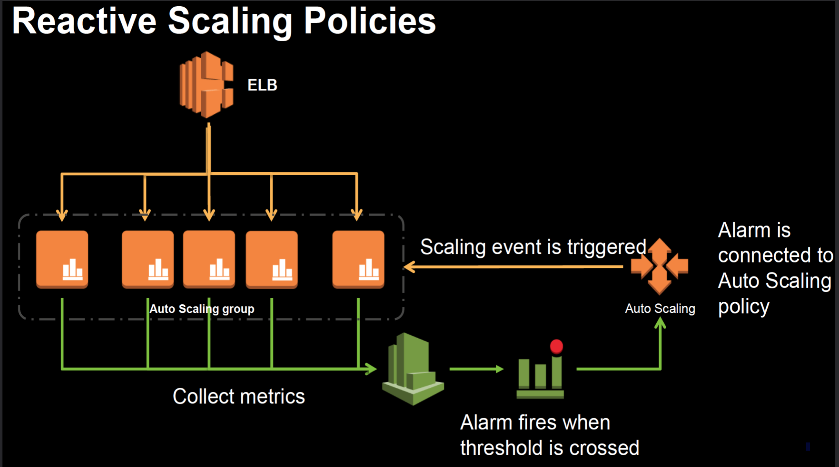
Scaling Approach
Notes:
GRant- reactive approach to utilize cloud alerts. Use of multiple instances, and availability zones.

Slide 29
Termination Policies
Longest running instance
Oldest launch configuration
Unhealthy Instances
Closest to full billing hour
Notes:
Grant - tend to slow down over time, oldest launch could have bugs or outdated code, unhealthy instances is self explanatory, closest to full billing hour to save costs

Slide 30
Database Encryption
Approach: Whole Database Approach
Reason for this approach:
-Simplest to implement
- Prevents the database from being attached to an unauthorized instance of SQL Server.
- Protects ALL information in a database including schema, stored procedures, all data points
Notes:
Charles

Slide 31
Database Encryption
Transparent Data Encryption (TDE)
Encrypts “Data at rest” or data that is not in transit (user email and name)
Encryption key is needed to encrypt the entire database at the file level.
Even if the data is compromised, only authorized users are allowed to decrypt the data.
Notes:
Charles

Slide 32

API Security
OAuth
Cloudflare Access
Allows users to authenticate with SSO
Can set up policies and rules to allow who can and cannot access site based on user identity, network attributes, and device posture
Notes:
Tameah

Slide 33
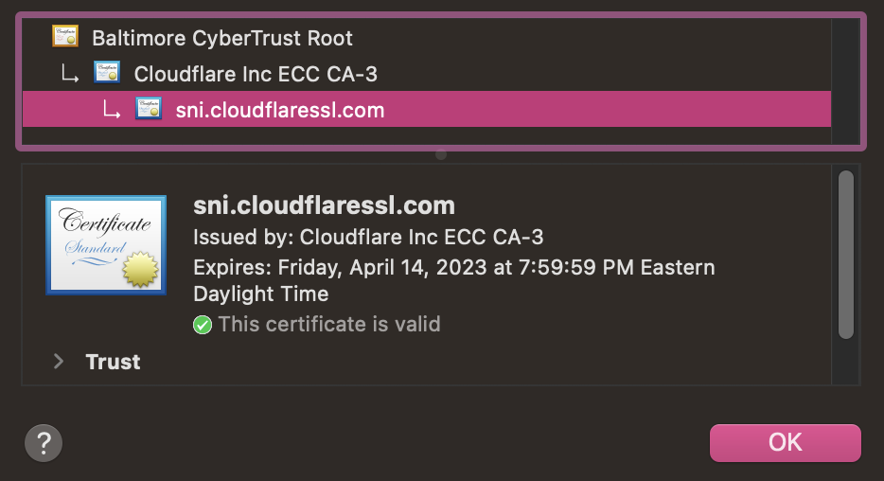
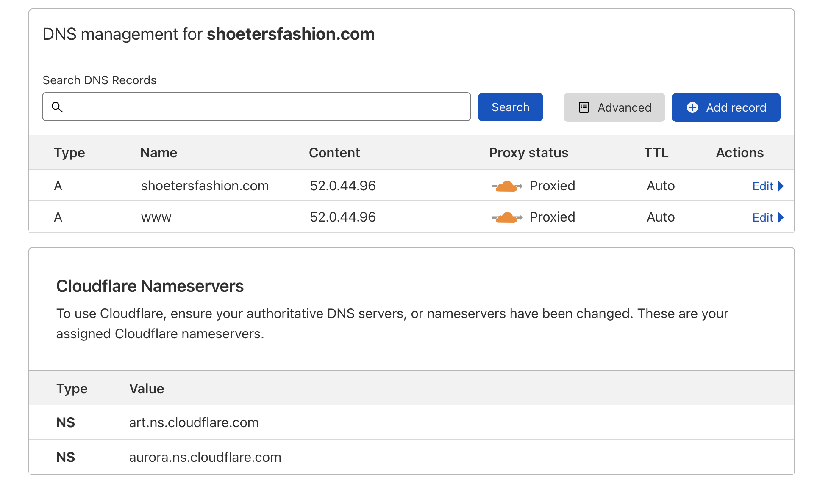
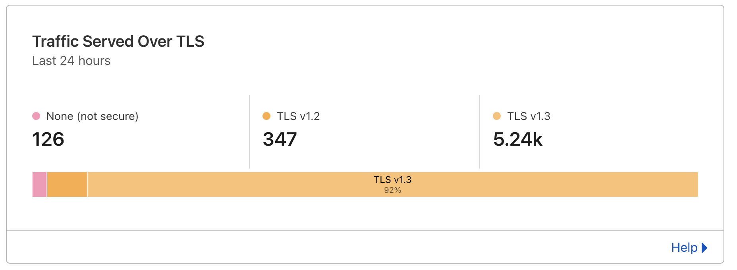
API Security
SSL - Cloudflare
Filters traffic
Had to change nameservers

Slide 34
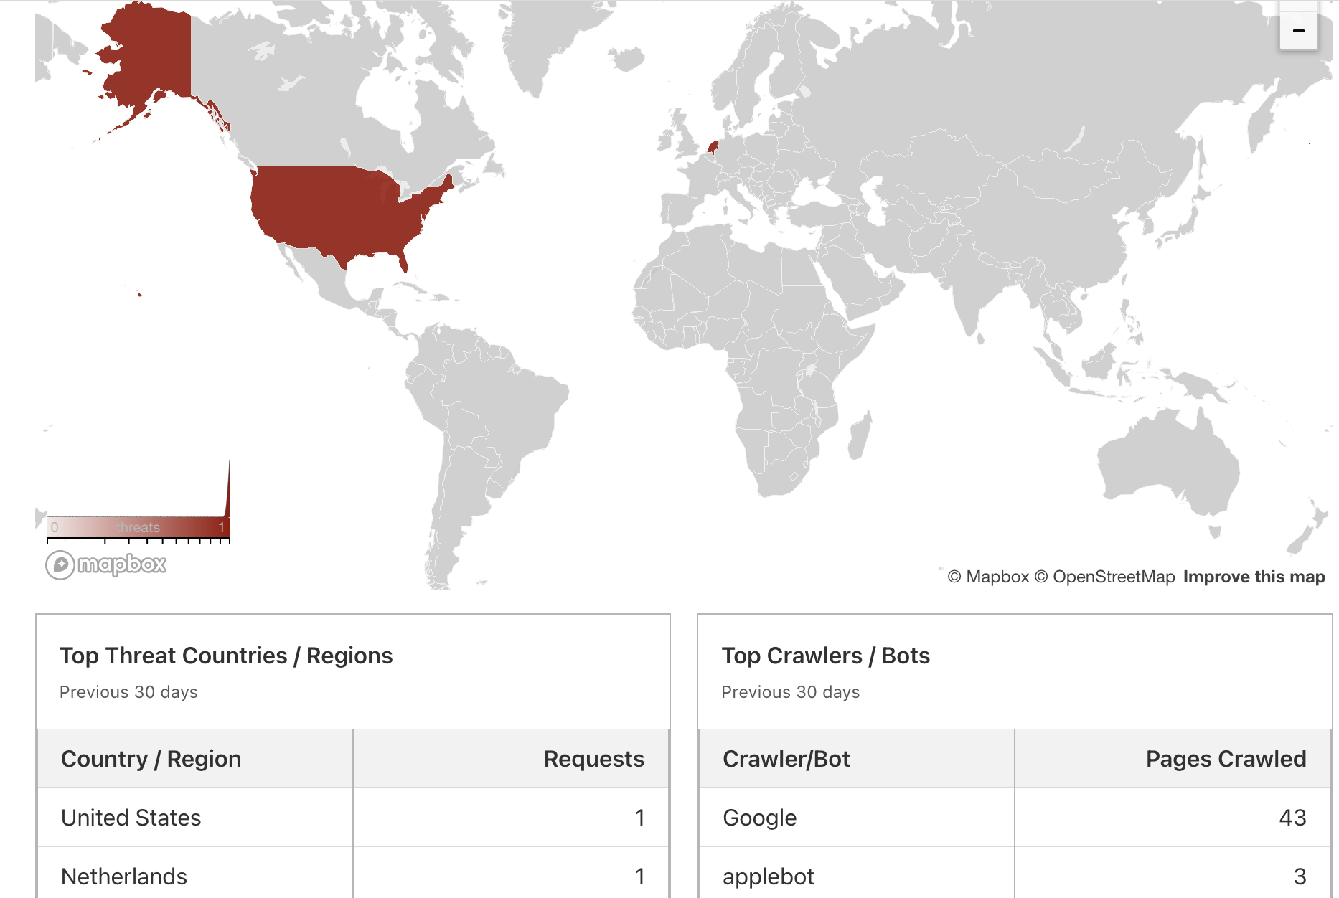
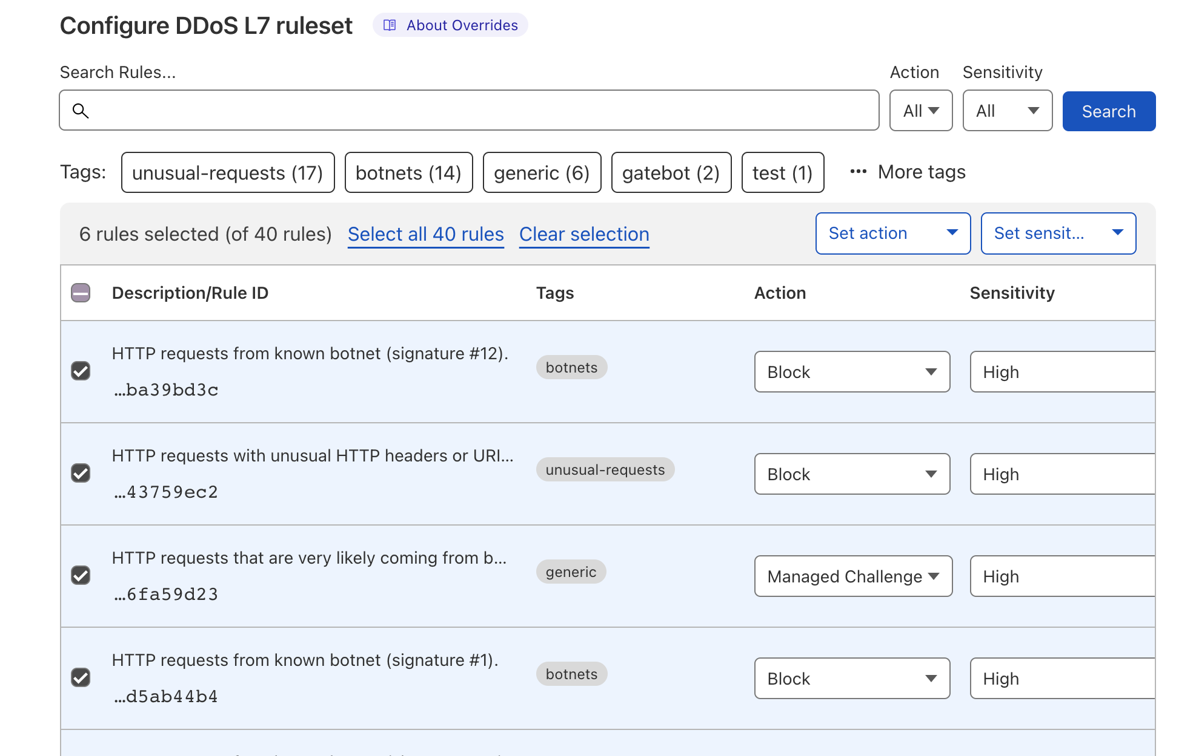
API Security

Slide 35
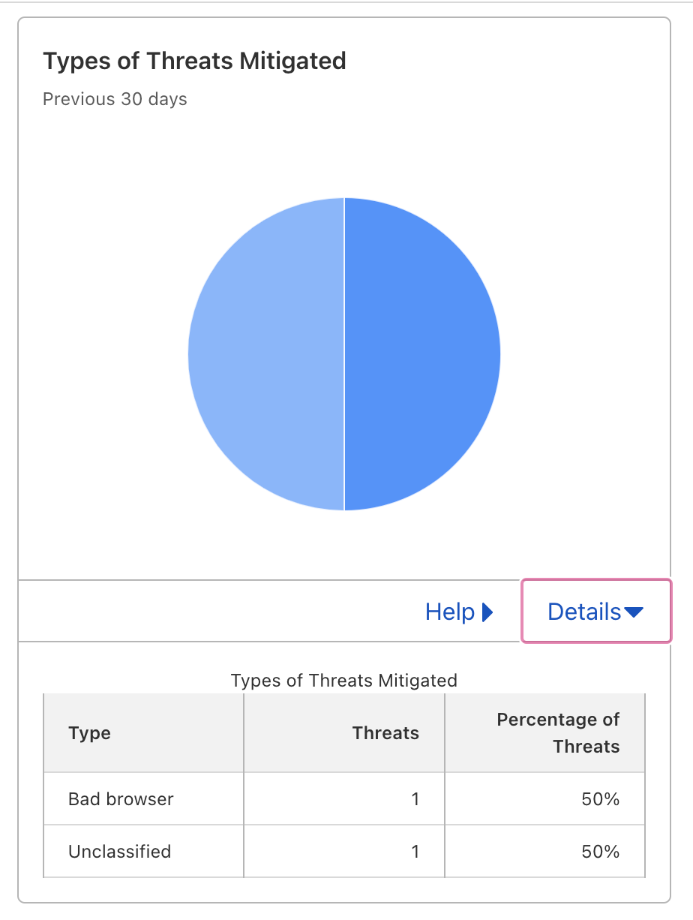
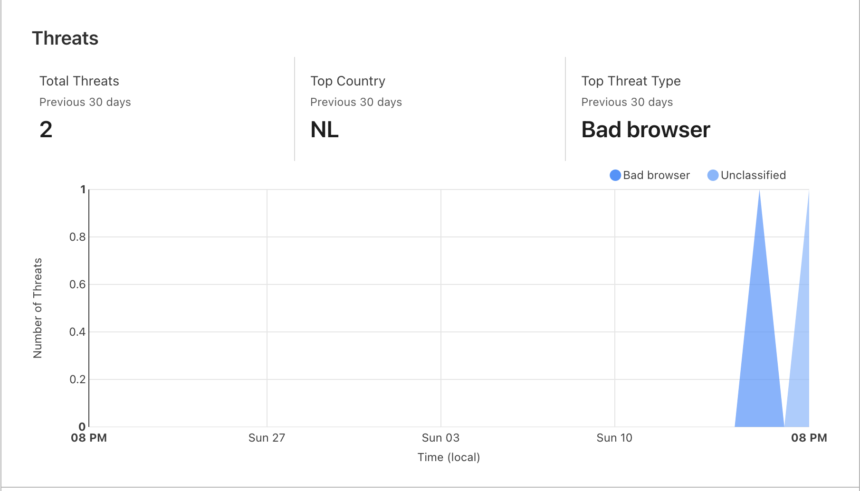
API Security

Slide 36
Live Demo
https://shoetersfashion.com/

